Slide 1
Creational Patterns
Dara

Slide 2
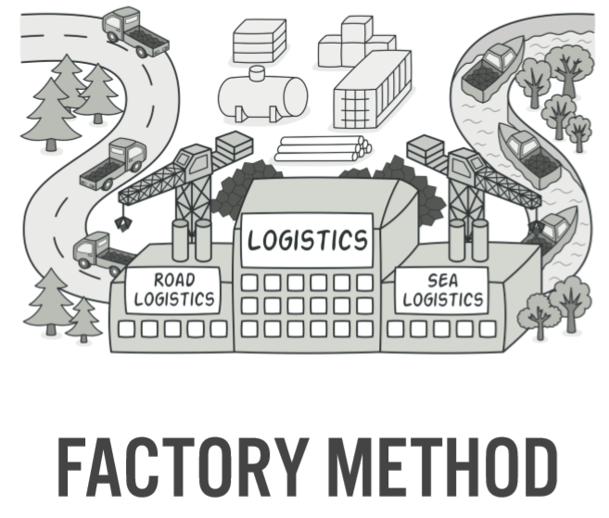
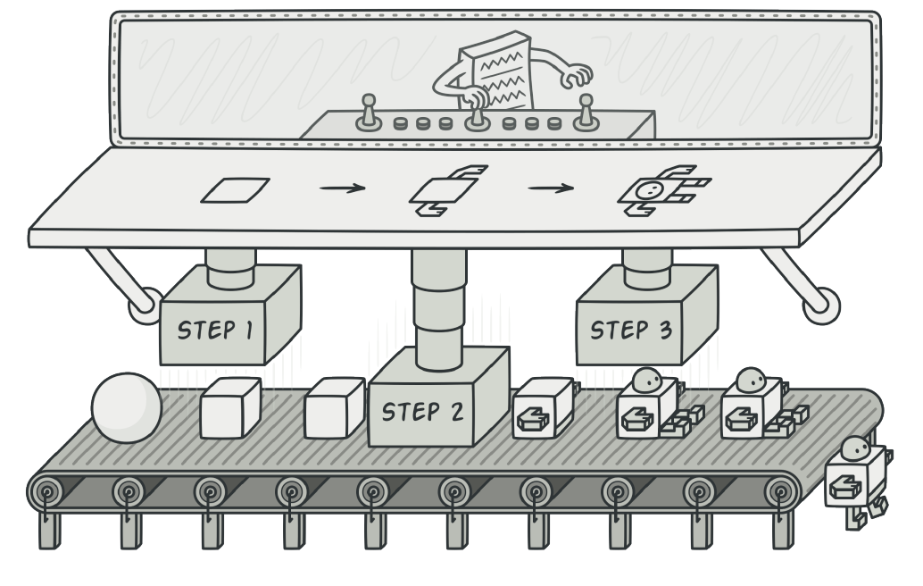

Slide 3
Factory Method
is a creational design pattern that provides an interface for creating objects in a superclass, but allows subclasses to alter the type of objects that will be created

Slide 4
Intent
Define an interface for creating an object, but let subclasses decide which class to instantiate. Factory Method lets a class defer instantiation to subclasses.
Defining a "virtual" constructor.
The "new" operator considered harmful.

Slide 5
Discussion
Factory Method is to creating objects as Template Method. A superclass specifies all standard and generic behavior (using pure virtual "placeholders" for creation steps), and then delegates the creation details to subclasses that are supplied by the client.
Factory Method makes a design more customizable and only a little more complicated. Other design patterns require new classes, whereas Factory Method only requires a new operation.

Slide 6
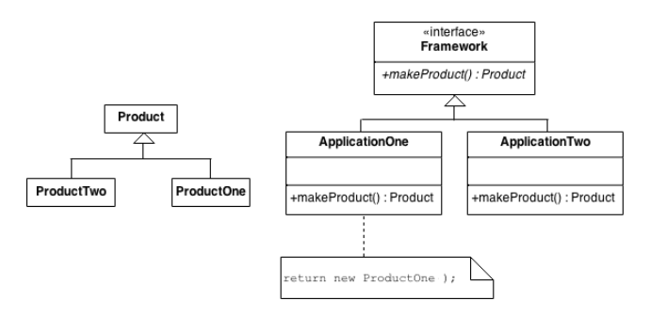
Structure

Slide 7
Structure
An increasingly popular definition of factory method is:
a static method of a class that returns an object of that class' type. But unlike a constructor, the actual object it returns might be an instance of a subclass.
Unlike a constructor, an existing object might be reused, instead of a new object created. Unlike a constructor, factory methods can have different and more descriptive names

Slide 8
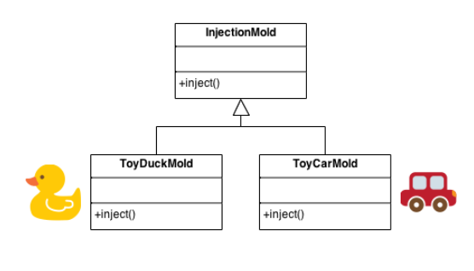
Example: Injection molding presses demonstrate this pattern. Manufacturers of plastic toys process plastic molding powder, and inject the plastic into molds of the desired shapes. The class of toy (car, action figure, etc.) is determined by the mold.

Slide 9
The new operator considered harmful. There is a difference between requesting an object and creating one. The new operator always creates an object, and fails to encapsulate object creation. A Factory Method enforces that encapsulation, and allows an object to be requested without inextricable coupling to the act of creation.

Slide 10
Advantages and Disadvantages
You avoid tight coupling between the creator and the concrete products.
Single Responsibility Principle. You can move the product creation code into one place in the program, making the code easier to support.
Open/Closed Principle. You can introduce new types of products into the program without breaking existing client code.
The code may become more complicated since you need to introduce a lot of new subclasses to implement the pattern. The best case scenario is when you’re introducing the pattern into an existing hierarchy of creator classes.

Slide 11
But what’s the difference between builder and factory method?

Slide 12
The Factory pattern can almost be seen as a simplified version of the Builder pattern.
In the Factory pattern, the factory is in charge of creating various subtypes of an object depending on the needs.
The user of a factory method doesn't need to know the exact subtype of that object. An example of a factory method createCar might return a Ford or a Honda typed object.
In the Builder pattern, different subtypes are also created by a builder method, but the composition of the objects might differ within the same subclass.
To continue the car example you might have a createCar builder method which creates a Honda-typed object with a 4 cylinder engine, or a Honda-typed object with 6 cylinders. The builder pattern allows for this finer granularity.

Slide 13
A factory is simply a wrapper function around a constructor (possibly one in a different class). The key difference is that a factory method pattern requires the entire object to be built in a single method call, with all the parameters pass in on a single line. The final object will be returned.
A builder pattern, on the other hand, is in essence a wrapper object around all the possible parameters you might want to pass into a constructor invocation. This allows you to use setter methods to slowly build up your parameter list. One additional method on a builder class is a build() method, which simply passes the builder object into the desired constructor, and returns the result.

